Slide 1
BRIGAM CITY CORPORATION’S
2013 – 2014 BUDGET
PRESENTATION
Presented By:
Tyler Vincent, Mayor Pro Tem
Notes:
The 2013-14 Fiscal Year budget I’m presenting this evening was received from Mayor Fife on May second of this year. Mayor Fife did a good job drafting his budget which the Council was able to review and modify within the appropriate time requirements. I would like to start my presentation this evening by discussing some of the capital projects that are included in this year’s budget.

Slide 2
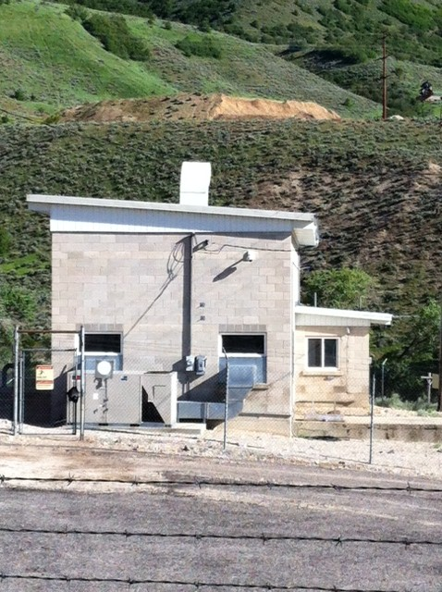
Department of Energy Grant
$1.9 mil project
$1 mil match
Notes:
A DOE grant was obtained several years ago to study the feasibility of constructing wind turbines in the mouth of Box Elder Canyon. When that project proved unfeasible, DOE allowed Brigham City to change the scope of work to replace the existing inefficient hydroelectric generator located in our upper power plant with a new generator to increase efficiency and energy output. If the grant had not been changed, the City would be facing a substantial investment for maintenance of the existing generator. An engineering firm has been selected for this project which needs to be completed by the end of August 2014.

Slide 3
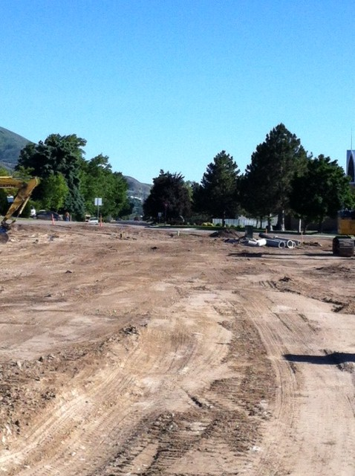
400 South 800 West Intersection
$296,000 budget for final phase
August 30th project completion
Major safety enhancement
Notes:
The 400 S 800 W intersection improvement project is a partnership between the Box Elder School District and the City. Property for right-of-way and credits for street improvement costs were exchanged between the entities to make this critical street realignment project happen. The overall public’s safety will be tremendously enhanced when this project is completed.

Slide 4
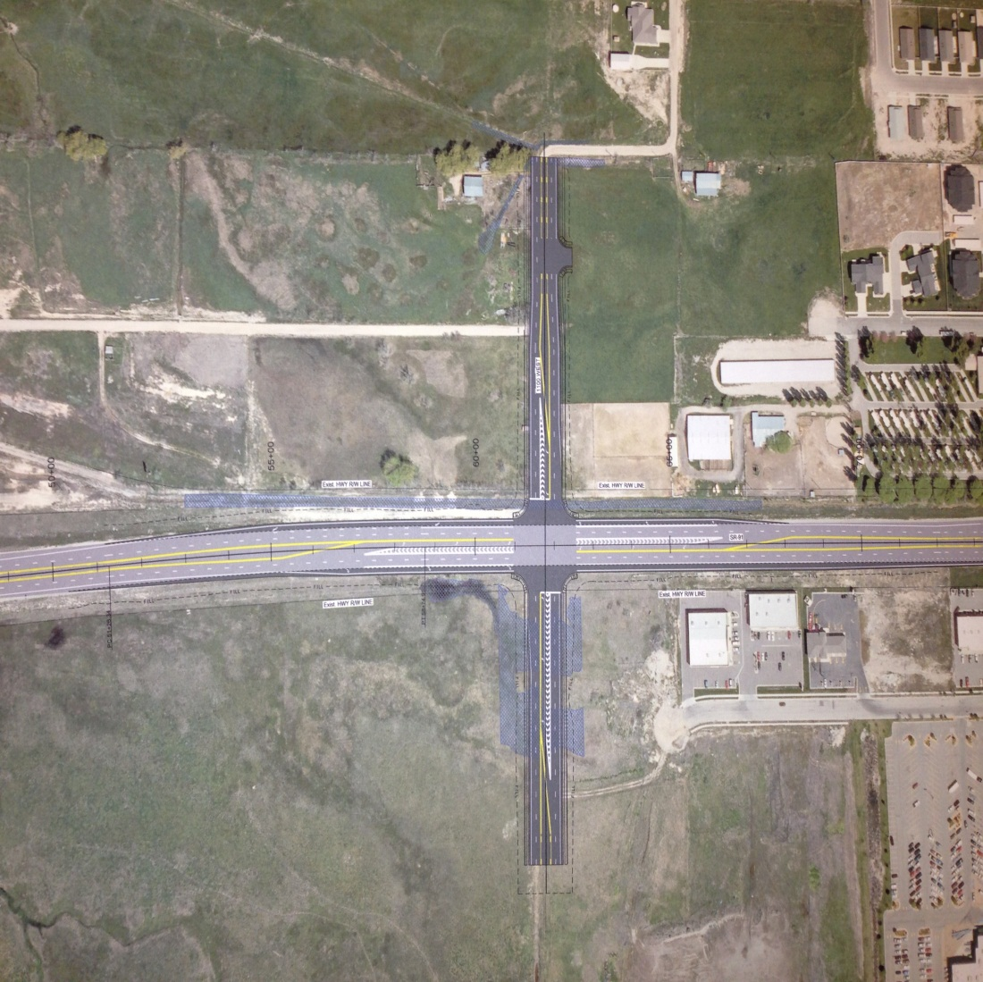
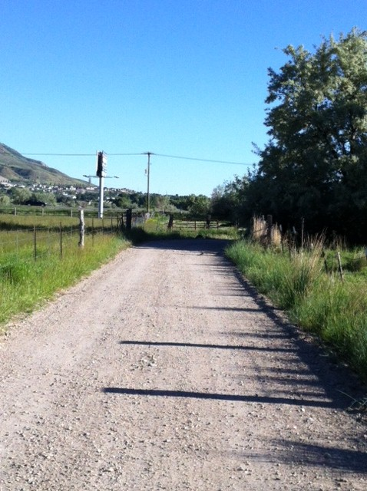
1100 South 1100 West Intersection
Future
Existing
Notes:
The Council has approved $25,000 to finish an environmental document that will help garner federal funding for this project. The project could take approximately three years to fund and construct but the economic benefits for the surrounding area is priceless. We believe the connecting streets that feed this intersection have the potential to develop into an arterial network similar to 10th West in Logan.

Slide 5
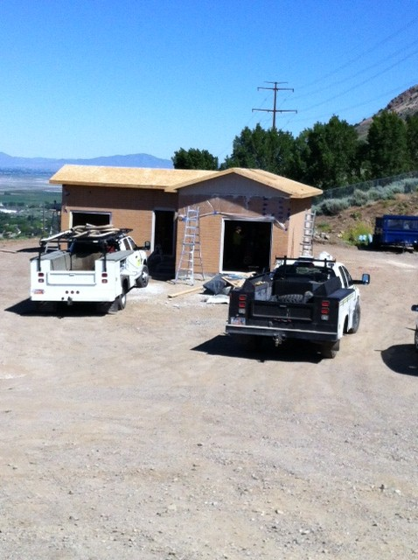
New Box Elder Canyon Well
$200,000 test well
$1.3 mil completed
$1.5 mil total
Flat Bottom Canyon Well
Notes:
The City has secured a water right to develop a new culinary well located in the mouth of Box Elder Canyon. Funding for drilling a test well and developing it into a culinary water source is estimated to cost $1.5 million. The project costs will be funded through the Procter & Gamble bonds issued to replace culinary water used for the operation of their plant. This photograph shows the Flat Bottom Canyon Well and pump house that is nearing completion.

Slide 6
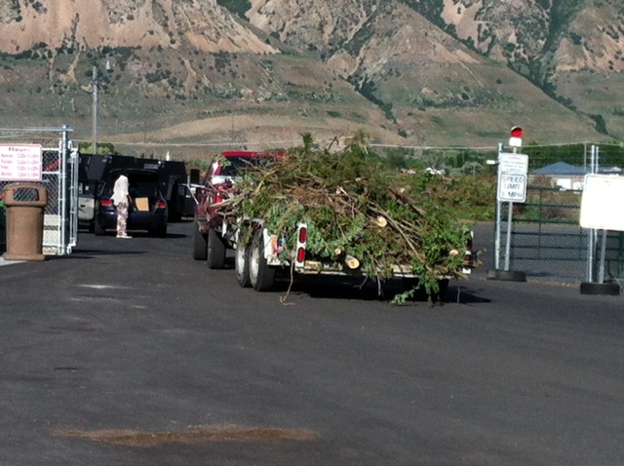
Green Waste/Recycling Center
Phase II development of the new site budgeted at $225,000
Project designed to triple the size of the facility
Notes:
The new Green Waste/Recycling Center was opened earlier this spring. The location change has increased efficiency of operations by combining waste treatment & composting operations on adjoining properties. The Center is well used by our citizen as well as those in the surrounding areas.

Slide 7
Financial Planning
Cash Needs of Brigham City
  Operations
  Contingencies
Future Planning – Major Items
  Facility Needs
  Electrical Source
Notes:
The Mayor & City Council considered the current cash needs of the City for operations and emergencies. The Council decided to establish a goal to write policies with cash targets for the City to ensure financial stability. Cash targets shall be established as a percentage of budgeted operating expenses plus additional reserves that may be needed for unexpected events. Currently Brigham City has adequate cash reserves to cover operations.
The Mayor & Council also determined that two major risks are currently facing the City and need to be addressed before things worsen. The risks are the aging and deterioration of city facilities and electrical energy alternatives.

Slide 8
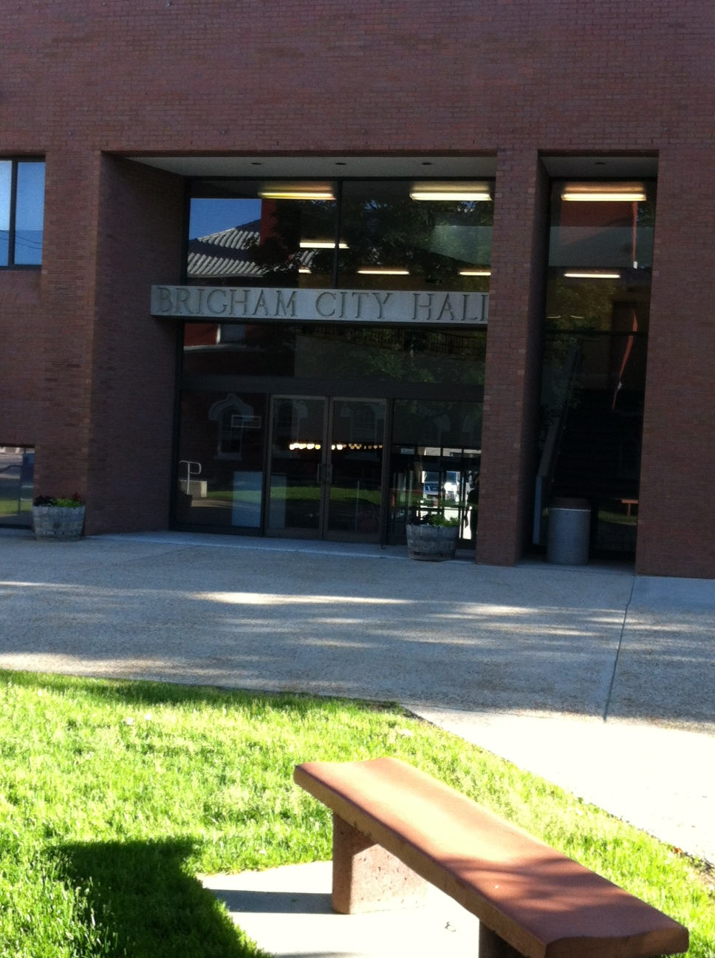
Facility Maintenance Needs
Swimming Pool
Condition of Other City Facilities
Long Term Solution
  Facility Fund Creation
Notes:
During the preparation of the budget it was noted that the swimming pool was loosing water rapidly due to various failures of the pool’s components. The plaster lining is 17 years old, which is several years past normal warranties, which generally range from 10 to 15 years for swimming pools. It is estimated that sufficient repairs to the pool will cost around $500,000.
Staff have also noted that many City facilities are aging, with little to no money being allocated for maintenance of these buildings. The buildings maintenance budget has been steadily increasing to pay for repairs of worn out materials. For example, City hall was constructed in 1973. We know that the building is not energy efficient and that there are problems arising with the heating and cooling system. Sufficient funding has not been allocated to facilitate projects due to the difficult economy we have all experienced the last few years.
The Mayor and Council determined that action needs to be taken to address this problem. The long-term solution decided upon was the creation of a capital facility fund that will function similar to the fleet fund currently used for vehicles. Although some of the details of the program haven’t been worked out yet, when assets that will wear out over time are purchased departments who use the assets will pay a lease payment each year to plan for the replacement of the asset. Also, any user fees related to facilities could go to offset the maintenance and replacement cost of the facilities.

Slide 9
Electrical Supply Source
Approximately 72% of City electricity is supplied from Rocky Mountain Power
Baseline cost of power is locked in through June 2015
Rocky Mountain Power has indicated they will increase costs by 29% if a new contract is negotiated
The City is searching for alternate power sources
Notes:
Approximately 72% of the electric power used in Brigham City is supplied by Rocky Mountain Power. The City has a contract with Rocky Mountain Power that locks in the baseline cost for the power through June 2015. Rocky Mountain Power has indicated that if a new contracted is negotiated in 2015 we should expect a 29% increase in the cost of power.
The Council believes that it is important that all possible alternative power sources need to be researched by the City to find a reliable source of power for the future of Brigham City. A retreat is currently being planned to discuss the direction the City wants to take in relation to power sources. All options are currently being explored.

Slide 10
Electrical Rate Increase
Billing Structure Change
The City has not increased customer electric rates since 2009
The cost of power from RMP has increased by 33% since the last rate increase
RMP’s proposed rate increase of 2.82% is budgeted to be added to customer bills beginning July 1st of 2013
A summer/winter rate structure is being implemented for customers beginning July of 2013
Electric users who use a lot of power will see higher bills in the summer and lower bills in the winter
Notes:
Electricity cost from Rocky Mountain Power over the past 4 years have increased by 33%. The City has not passed any rate increases on to our customers for the past several years, which has reduced funds available for capital projects in the Electrical Department. The Mayor and Council have determined that we no longer can absorb power rate increases so a 2.82% rate increase which we are about to receive from RMP will be added to our customers’ utility bill beginning this next fiscal year.
In addition, starting in July, the City will begin using a seasonal tiered rate structure for charging power usage to customers. The new rate structure will have separate summer and winter rates that are tiered usage. For example, if a customer is a high power user in the summer their bill will increase when compared to the prior year. If a customer is a low power user in the winter their bill will decrease when compared to the prior year. The change is designed to give customers the opportunity to control their power costs based on their usage habits. There are no other utility rate increases being proposed in this year’s budget.

Slide 11
City Equipment & Vehicles
17 vehicles budgeted to be purchased
$786,000 net cost to the City
(after projected trade in values)
Notes:
The city has budgeted $786,000 in funding for the replacement of 17 pieces of equipment and vehicles. These purchases will help maintain the relatively good condition of the City fleet. Money received from departments for equipment lease payments during the year is used to purchase vehicles and equipment.

Slide 12
New Impact Fee Study
Impact fees are charged to make sure that new users of systems are paying for their impact to the system
Impact fees must be evaluated to determine their appropriate level
A new study to evaluate the appropriate level of impact fees has been budgeted
Brigham City collects impact fees for water, wastewater, electric, storm drain, and park operations
Notes:
It is recommended that impact fees are reviewed every six years to address economical changes which means they can go up or down depending on the economy.

Slide 13
Merit & Market Adjustments
2.1% merit increase
0.4% market adjustment
2.1% CPI for 2012
Notes:
This year the Council has approved a 2.1% merit and 0.4% market adjustment for the employees of our city. The merit increase mirrors the Consumer Price Index for 2012 of 2.1%. There have been numerous reductions in City staffing over the past several years and our employees have absorbed the extra work loads with enthusiasm and efficiency. The elected officials of this community are very proud of our employees and recognize all they do in providing services for this community.

Slide 14
Fiscal Year 2013-2014 Budget
General Fund - $10,749,000
Utility Fund - $22,622,000
All Other Funds - $10,331,000
Total - $43,702,000
Notes:
Read the slide. Recap of 2013-2014 budget

Slide 15
Notes:
This slide shows the sources of revenue in the general fund. Transfers account for 26% of revenue. Sales taxes account for an additional 25% of revenue. Property taxes are only 6% of revenue in the general fund.

Slide 16
Notes:
This slide shows the budgeted spending in the general fund.

Slide 17
Notes:
This chart shows total budget by fund type. Utility funds are over 50% of the total budget. The general fund is an additional 25% of the total budget.

Slide 18
Thank You
Notes:
The preparation of the budget was difficult this year. I would like to thank the Council for their time and efforts to prepare the budget.
I would also like to thank the City staff for their diligence in working through the budget process and making adjustments to their budget when asked. You all did a great job and we are looking forward to another successful year.

